Slide 1
4.3 Conflict Equivalent
In the conflict equivalent, one can be transformed to another by swapping non-conflicting operations. In the given example, S2 is conflict equivalent to S1 (S1 can be converted to S2 by swapping non-conflicting operations).
Two schedules are said to be conflict equivalent if and only if:
They contain the same set of the transaction.
If each pair of conflict operations are ordered in the same way.

Slide 2
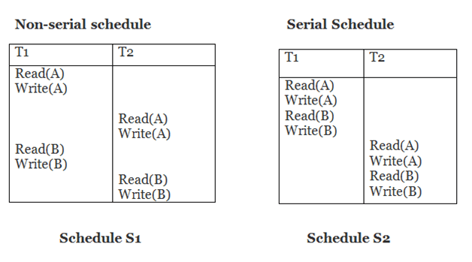
Example:
Schedule S2 is a serial schedule because, in this, all operations of T1 are performed before starting any operation of T2.
Schedule S1 can be transformed into a serial schedule by swapping non-conflicting operations of S1.

Slide 3
After swapping of non-conflict operations, the schedule S1 becomes:
T1 | T2
Read(A) Write(A) Read(B) Write(B) | Read(A) Write(A) Read(B) Write(B)
Since, S1 is conflict serializable.

Slide 4
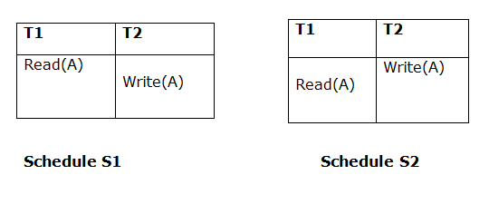
View Serializability
A schedule will view serializable if it is view equivalent to a serial schedule.
If a schedule is conflict serializable, then it will be view serializable.
The view serializable which does not conflict serializable contains blind writes.
View Equivalent
Two schedules S1 and S2 are said to be view equivalent if they satisfy the following conditions:
1. Initial Read
An initial read of both schedules must be the same. Suppose two schedule S1 and S2. In schedule S1, if a transaction T1 is reading the data item A, then in S2, transaction T1 should also read A.
Above two schedules are view equivalent because Initial read operation in S1 is done by T1 and in S2 it is also done by T1.

Slide 5
Updated Read
In schedule S1, if Ti is reading A which is updated by Tj then in S2 also, Ti should read A which is updated by Tj.
Above two schedules are not view equal because, in S1, T3 is reading A updated by T2 and in S2, T3 is reading A updated by T1.

Slide 6
Final Write
A final write must be the same between both the schedules. In schedule S1, if a transaction T1 updates A at last then in S2, final writes operations should also be done by T1.
Above two schedules is view equal because Final write operation in S1 is done by T3 and in S2, the final write operation is also done by T3.
Example:

Slide 7
Schedule S
With 3 transactions, the total number of possible schedule
= 3! = 6
S1 = <T1 T2 T3>
S2 = <T1 T3 T2>
S3 = <T2 T3 T1>
S4 = <T2 T1 T3>
S5 = <T3 T1 T2>
S6 = <T3 T2 T1>
Taking first schedule S1:
Schedule S1
Step 1: final updation on data items
In both schedules S and S1, there is no read except the initial read that's why we don't need to check that condition.
Step 2: Initial Read
The initial read operation in S is done by T1 and in S1, it is also done by T1.
Step 3: Final Write
The final write operation in S is done by T3 and in S1, it is also done by T3. So, S and S1 are view Equivalent.
The first schedule S1 satisfies all three conditions, so we don't need to check another schedule.
Hence, view equivalent serial schedule is:
T1 → T2 → T3

Slide 8
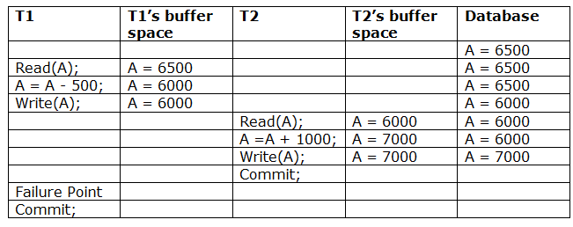
Recoverability of Schedule
Sometimes a transaction may not execute completely due to a software issue, system crash or hardware failure. In that case, the failed transaction has to be rollback.
But some other transaction may also have used value produced by the failed transaction. So we also have to rollback those transactions.
The above table 1 shows a schedule which has two transactions. T1 reads and writes the value of A and that value is read and written by T2.
T2 commits but later on, T1 fails. Due to the failure, we have to rollback T1. T2 should also be rollback because it reads the value written by T1,
but T2 can't be rollback because it already committed. So this type of schedule is known as irrecoverable schedule.

Slide 9
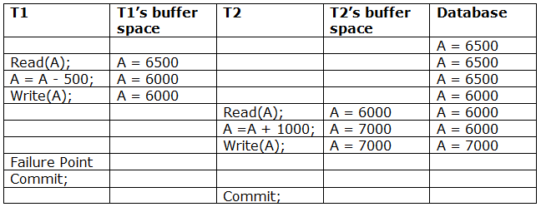
Irrecoverable schedule:
The schedule will be irrecoverable if Tj reads the updated value of Ti and Tj committed before Ti commit.
The above table 2 shows a schedule with two transactions. Transaction T1 reads and writes A,
and that value is read and written by transaction T2. But later on, T1 fails.
Due to this, we have to rollback T1. T2 should be rollback because T2 has read the value written by T1.
As it has not committed before T1 commits so we can rollback transaction T2 as well.
So it is recoverable with cascade rollback.

Slide 10
Recoverable with cascading rollback
The schedule will be recoverable with cascading rollback if Tj reads the updated value of Ti. Commit of Tj is delayed till commit of Ti.
The above Table 3 shows a schedule with two transactions. Transaction T1 reads and write A and commits, and that value is read and written by T2. So this is a cascade less recoverable schedule.

